Slide 1
Integrating Kubernetes and Azure
Sam Cogan
Solution Architect, Willis Towers Watson & Microsoft MVP
samcogan.com
@samcogan

Slide 2

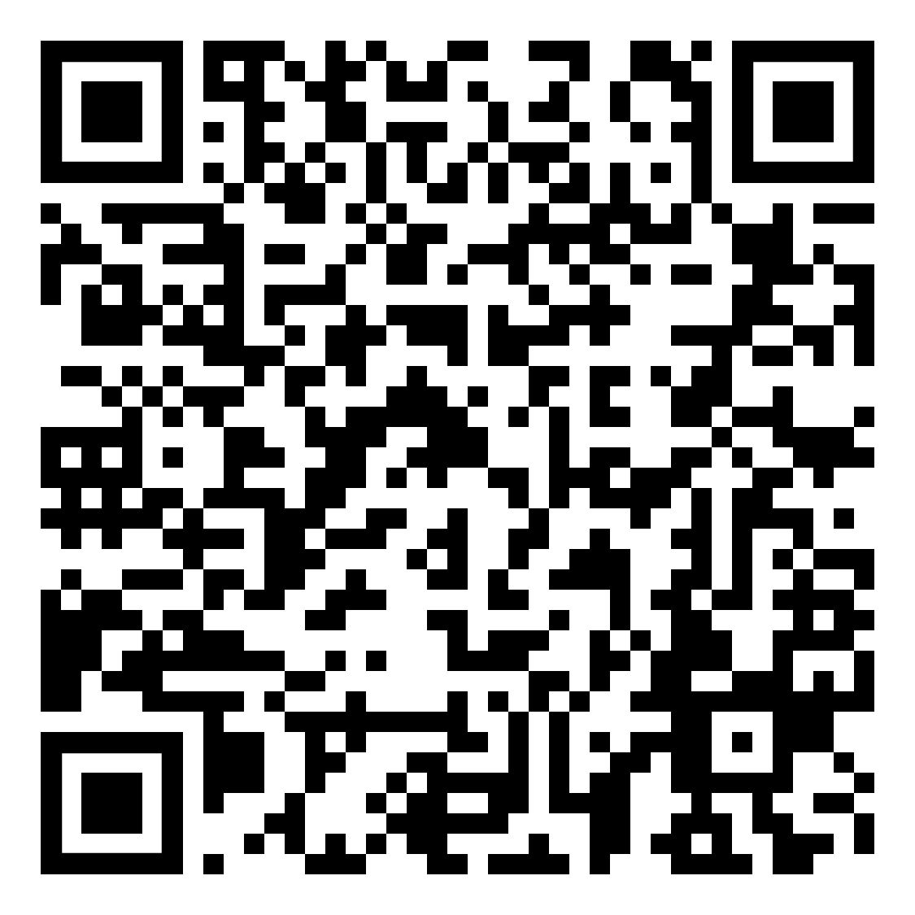



About Me
Sam Cogan
Solution Architect – Willis Towers Watson
Microsoft Azure MVP
samcogan.com
@samcogan
sam-cogan

Slide 3










Slide 4
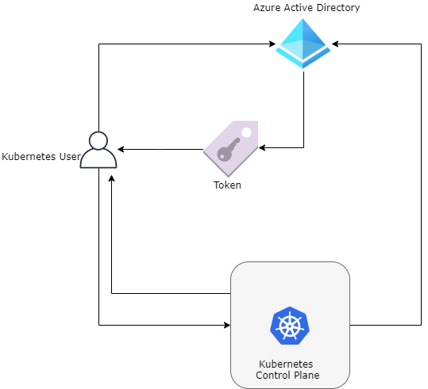
Azure AD Integration

Slide 5
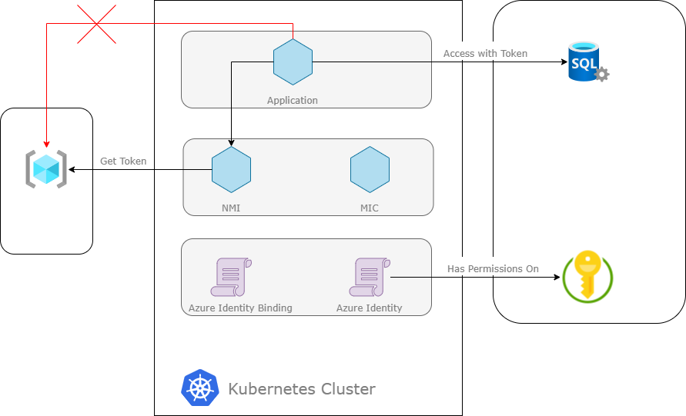
Pod Identity

Slide 6
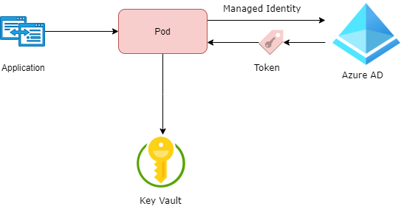
Key Vault
Key Vault Flex Volume - https://github.com/Azure/kubernetes-keyvault-flexvol
Key Vault to Kubernetes - https://github.com/SparebankenVest/azure-key-vault-to-kubernetes

Slide 7
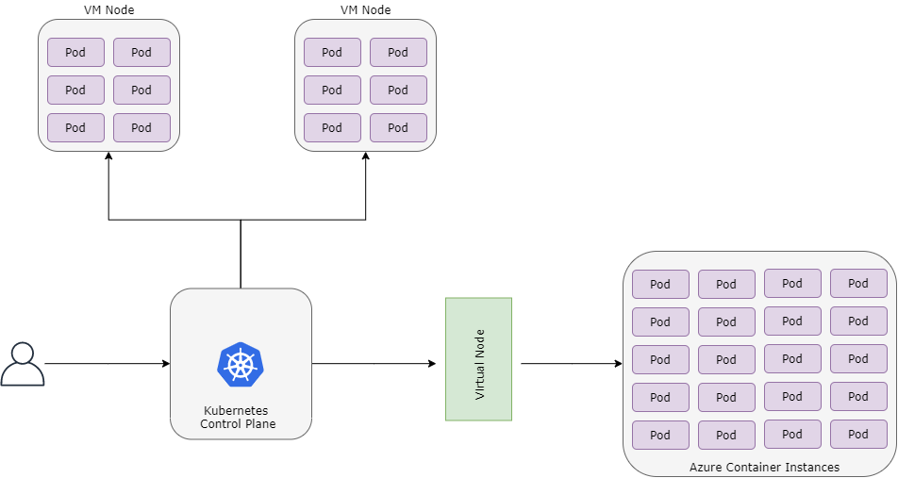
Virtual Node

Slide 8


Monitoring & Scaling
Promitor - https://promitor.io/
Keda - https://github.com/kedacore/keda

Slide 9
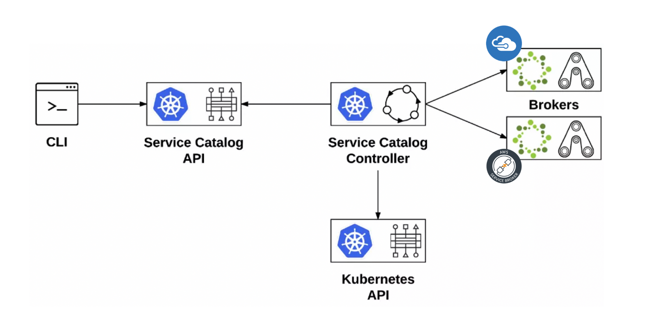
Open Service Broker for Azure

Slide 10
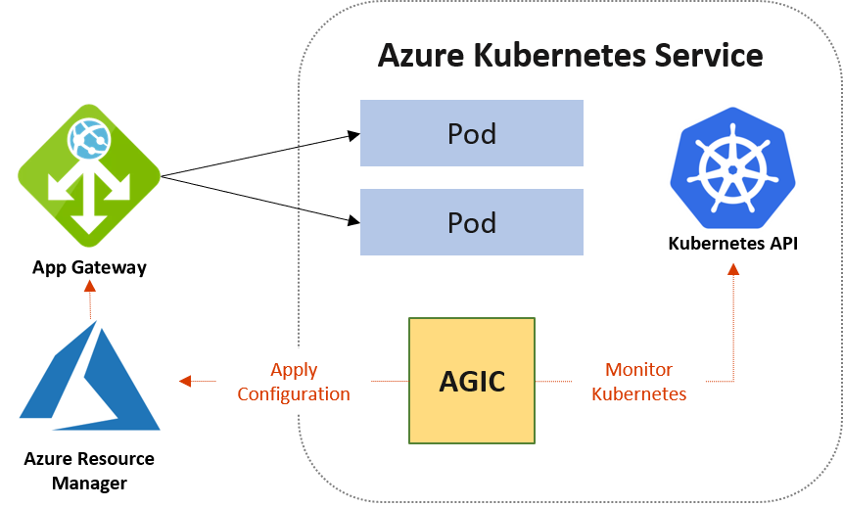
App Gateway

Slide 11
About Me
Sam Cogan
Solution Architect – Willis Towers Watson
Microsoft Azure MVP
samcogan.com
@samcogan
sam-cogan

Slide 12














Thank you Sponsors!

Slide 13
Please submit your feedback
Don’t forget to rate this session in the conference app
Thank you!

Slide 14
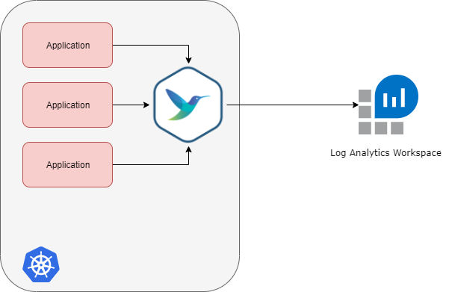
Fluent Bit Logging

